Slide 1

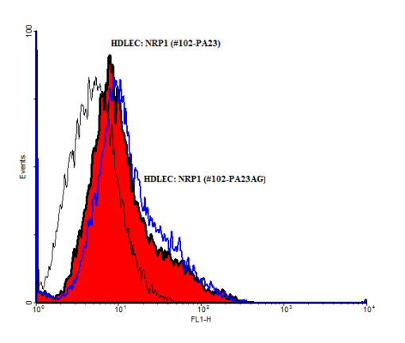
ReliaTech GmbH
Rabbit anti-human CD105
(Cat #102-PA23 / 102-PA23AG)
Fig. 1: FACS analysis with primary human dermal lymphatic endothelial cells (HDLEC).
http://www.reliatech.de / orders@reliatech.de

